Slide 1


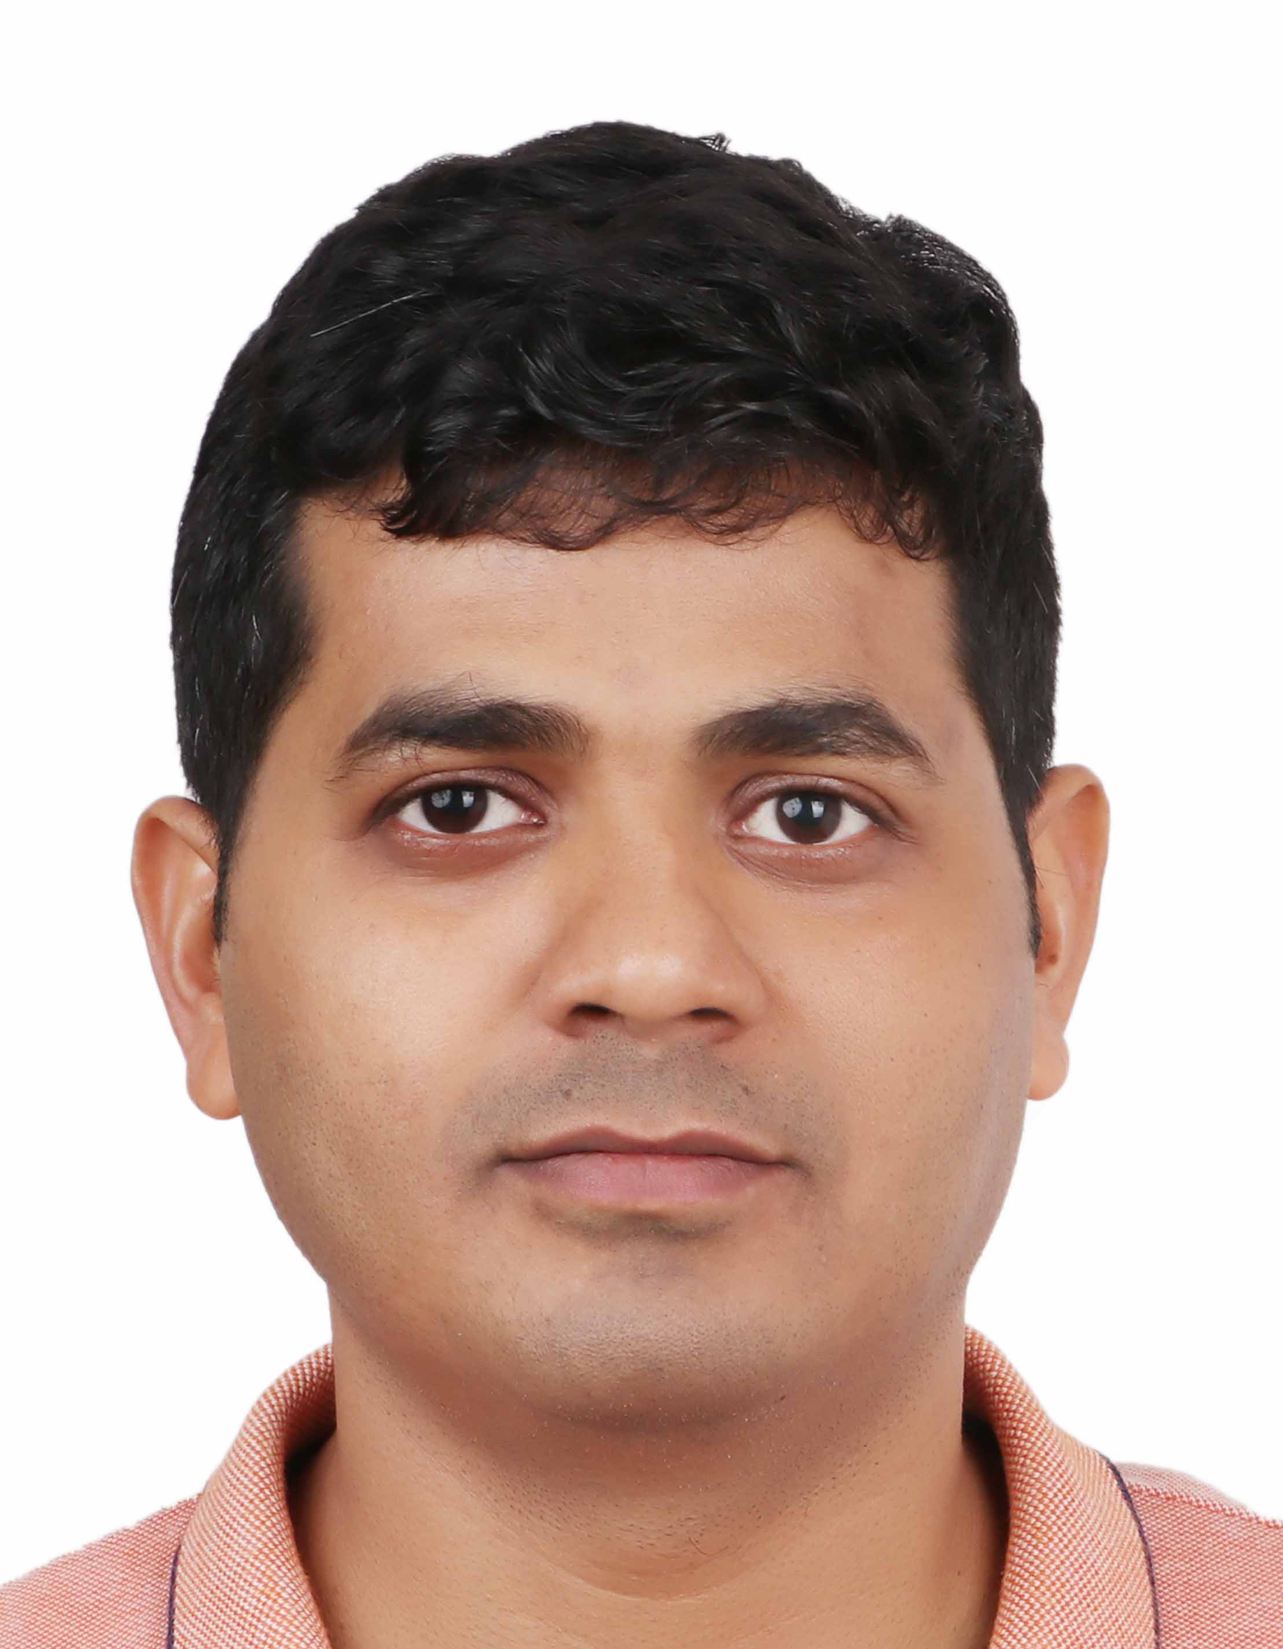
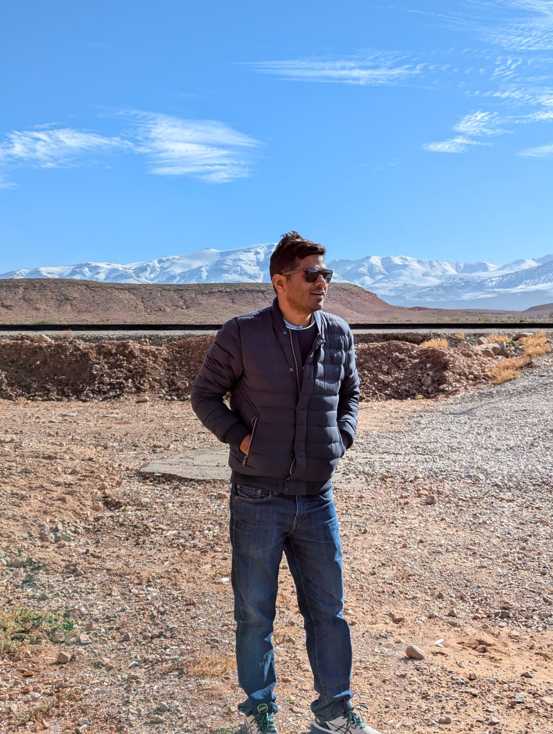
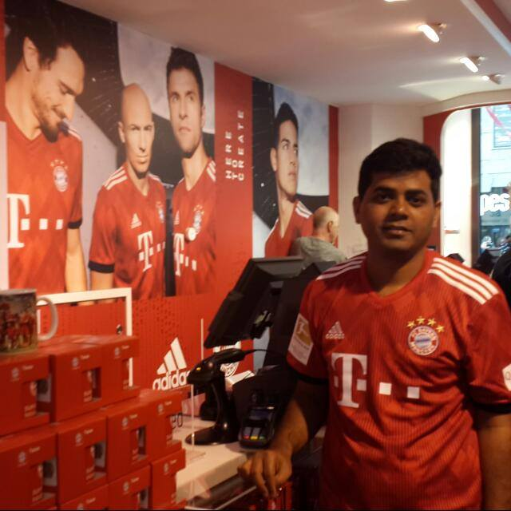
Getting to Know Me
Work
Personal
My role
B2B Dairy
Significant others / family members / furry friends in my life
Wife
Tenure in ofi/Olam
13 yrs
How I enjoy spending my free time
Reading , watching football
Previous companies I have worked at
TCS
My favorite / comfort food
Daal roti
Why I joined ofi/Olam and what keeps me here?
Challenging work to stretch myself
My favorite song
Text
Vipin Patel
Vipin
A few fun facts about me
Before coming to Nigeria , I had no idea of Chelsea or Arsenal. But now , I can name their playing eleven.
This is me outside work, doing stuff I enjoy in my life …

